Slide 1

8th Grade Math: Pre-Algebra
Unit 7, Lesson 4 Graphing Lines from Slope-Intercept Form Volume 1, pg. 298

Slide 2


Benchmark
MA.8.AR.3.4
Given a mathematical or real-world context, graph a two-variable linear equation from a written description, a table, or an equation in slope-intercept form.
volume 1, pg. 298

Slide 3
Integrated Mathematical Thinking and Reasoning Standard
MA.K12.MTR.4.1 Engage in discussions that reflect on the mathematical thinking of self and others.
volume 1, pg. 298

Slide 4

Learning Targets
I can graph a two-variable linear equation from an equation in slope-intercept form.
I can graph a two-variable linear equation from a table of values.
volume 1, pg. 298

Slide 5

Warm-Up
volume 1, pg. 298

Slide 6
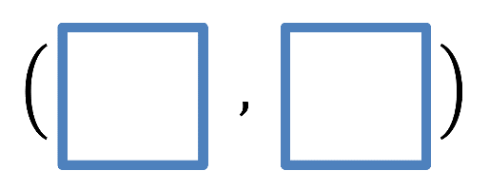
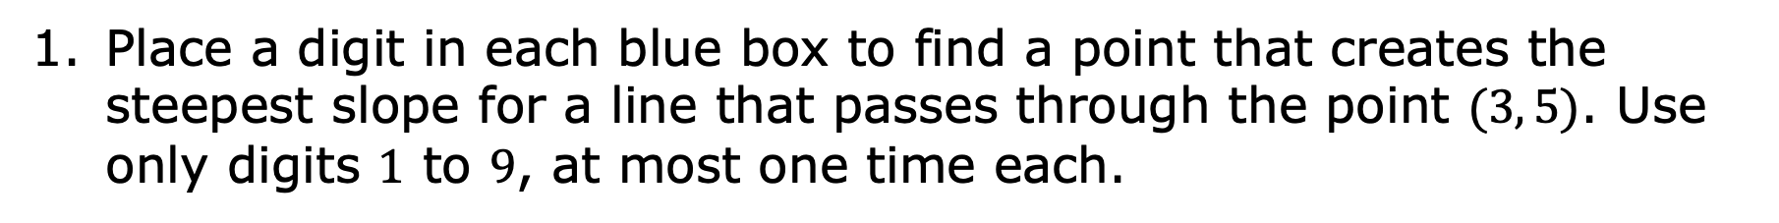
7.4.1 Warm-Up: Maximizing Slope
Place a digit in each blue box to find a point that creates the steepest slope for a line that passes through the point $(3, 5)$. Use only digits $1$ to $9$, at most one time each.
volume 1, pg. 298

Slide 7

Guided Instruction
volume 1, pg. 299

Slide 8

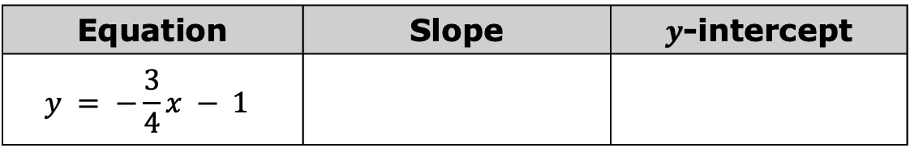
7.4.2 Guided Instruction: Graphing Two-Variable Linear Equations
The graph of a linear relationship can be created from a two-variable linear equation.
When given the equation in slope-intercept form, start by determining the slope and the 𝑦-intercept of the line.
Complete the table.
Equation | Slope | $y$-intercept
$$y = −\frac{3}{4}x − 1$$
volume 1, pg. 299

Slide 9
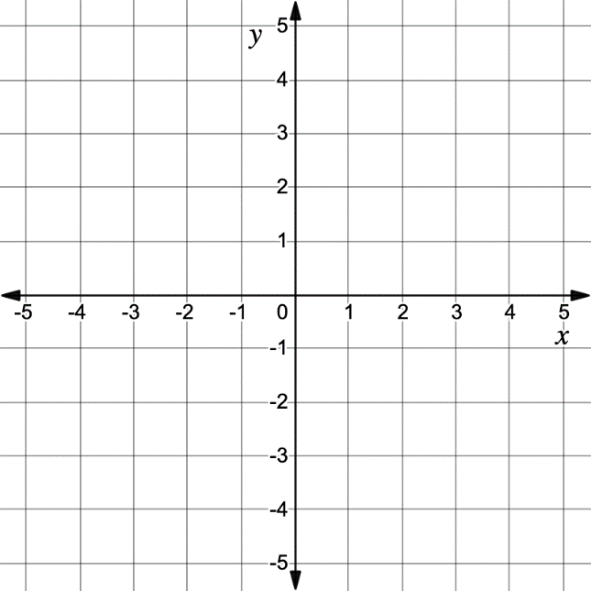
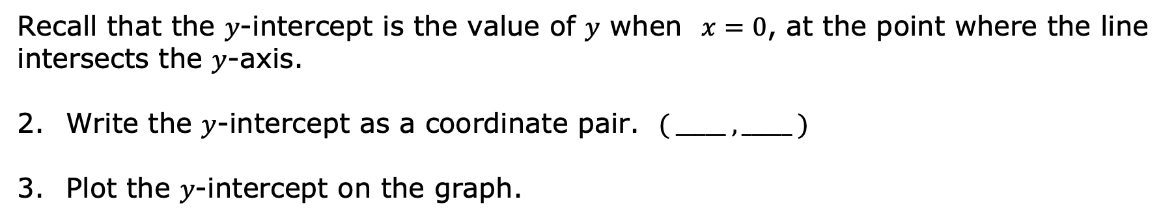
Recall that the 𝑦-intercept is the value of 𝑦 when $x=0$, at the point where the line intersects the 𝑦-axis.
Write the 𝑦-intercept as a coordinate pair. $( _____ , _____ )$
Plot the 𝑦-intercept on the graph.
volume 1, pg. 299

Slide 10
Use the slope to find two other points on the line.
Use a straightedge to draw the line that represents the linear relationship.
Two-variable linear relationships can also be written in other forms. When given the equation in another form, start graphing by determining points on the line using the equation.
volume 1, pg. 299

Slide 11
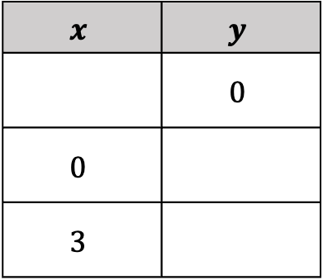
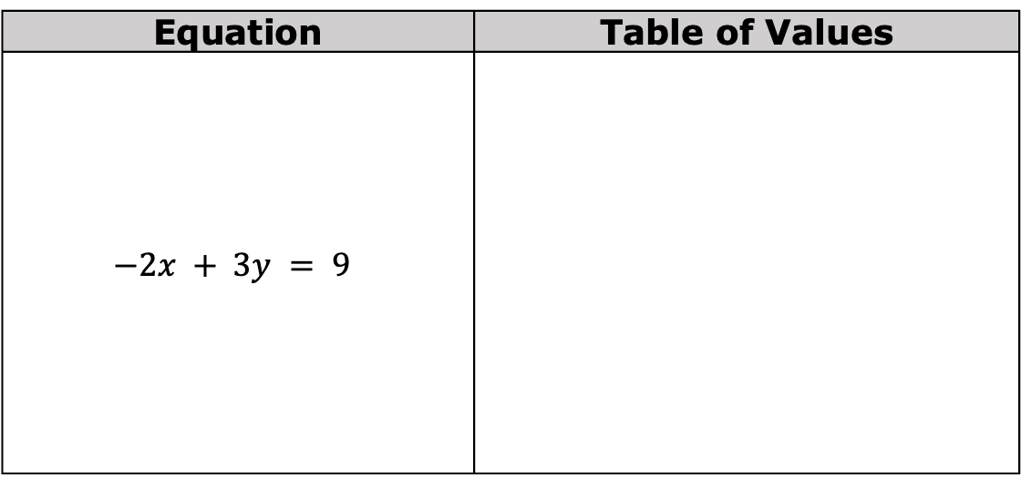
Complete the table of values using the equation.
Equation | Table of Values
$$−2x + 3y = 9$$
$$x$$ | $$y$$
 | $$0$$
$$0$$
$$3$$
volume 1, pg. 300

Slide 12
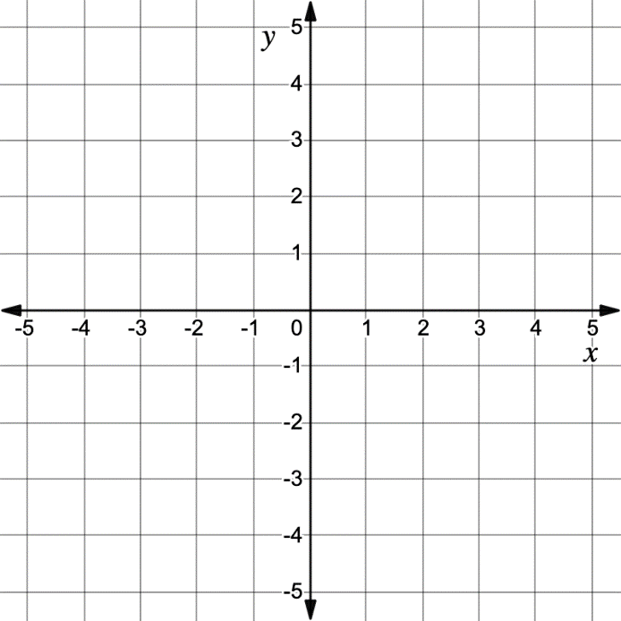
Plot the ordered pairs from the table of values on the graph. Then, use a straightedge to draw the line that represents the linear relationship.
volume 1, pg. 300

Slide 13
Ana says that to graph a linear relationship, only two points on the line are needed.
Discuss with your partner whether you agree or disagree with Ana and explain why.
volume 1, pg. 300

Slide 14
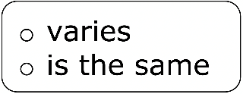
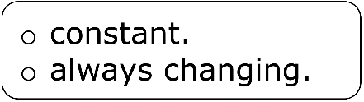
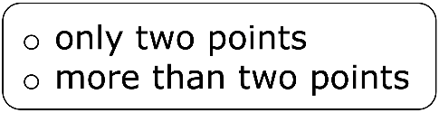
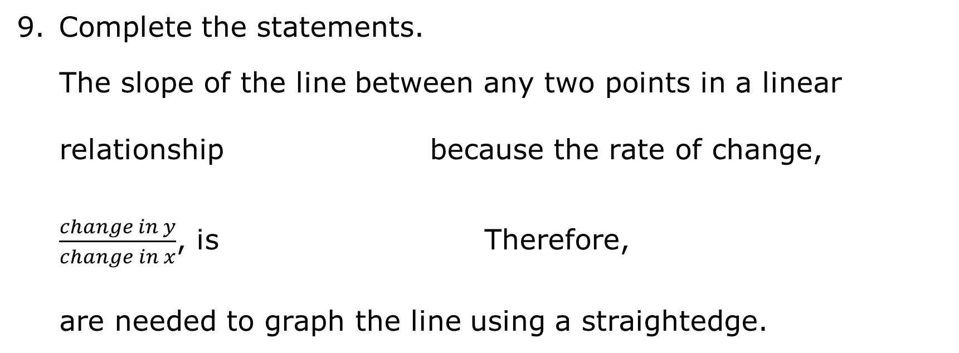
Complete the statements.
The slope of the line between any two points in a linear relationship because the rate of change, $\frac{change in y}{change in x}$, is Therefore, are needed to graph the line using a straightedge.
volume 1, pg. 300

Slide 15
When given the equation of a line in slope-intercept form, two points on the line can be determined using the 𝑦-intercept and slope. Start by graphing the 𝑦-intercept. Then, use the slope to determine a second point to graph from there.
When given the equation of a line in a form other than slope-intercept, two points on the line can be determined by using substitution to create a table of values.
volume 1, pg. 300

Slide 16

Try It
volume 1, pg. 301

Slide 17


7.4.3 Try It: Graphing Two-Variable Linear Equations
Graph the equation $y = −\frac{5}{2} x − 1$.
volume 1, pg. 301

Slide 18

Graph the equation $y = 3x − 5$.
volume 1, pg. 301

Slide 19
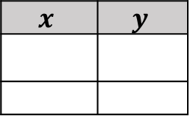
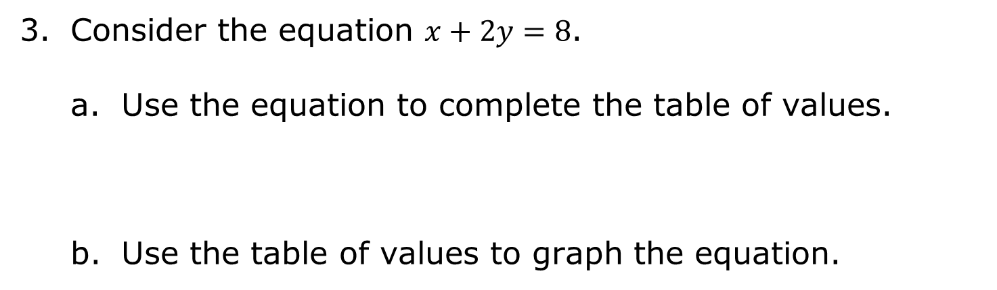
Consider the equation $x+2y=8$.
Use the equation to complete the table of values.
Use the table of values to graph the equation.
$$x$$ | $$y$$
volume 1, pg. 302

Slide 20

Collaboration
volume 1, pg. 302

Slide 21

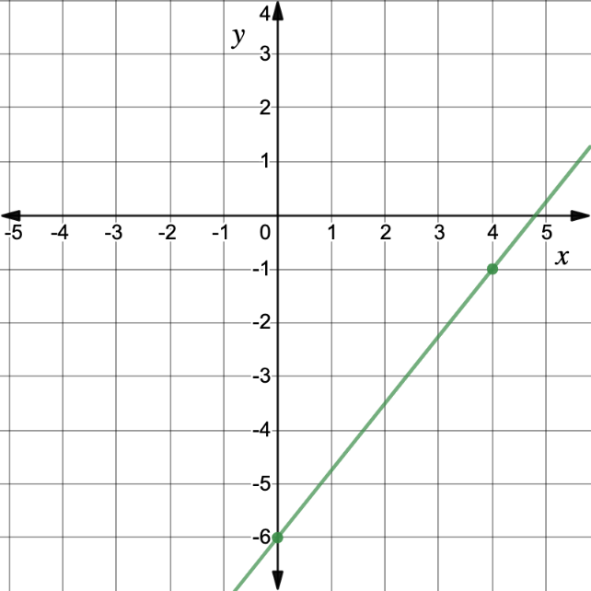
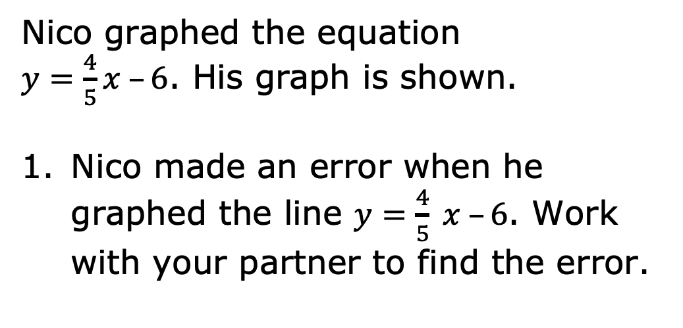
7.4.4 Collaboration: Error Analysis
Nico graphed the equation
$y=\frac{4}{5}x –6$. His graph is shown.
Nico made an error when he graphed the line $y=\frac{4}{5} x –6$. Work with your partner to find the error.
volume 1, pg. 302

Slide 22
Help Nico understand how he can learn from his mistake. Write a brief note to Nico explaining what he did correctly, what his mistake was, and how he can learn from it.
volume 1, pg. 302

Slide 23

Your Turn
volume 1, pg. 303

Slide 24


7.4.5 Your Turn!
Graph the equation $y=\frac{3}{4} x –2$.
volume 1, pg. 303

Slide 25
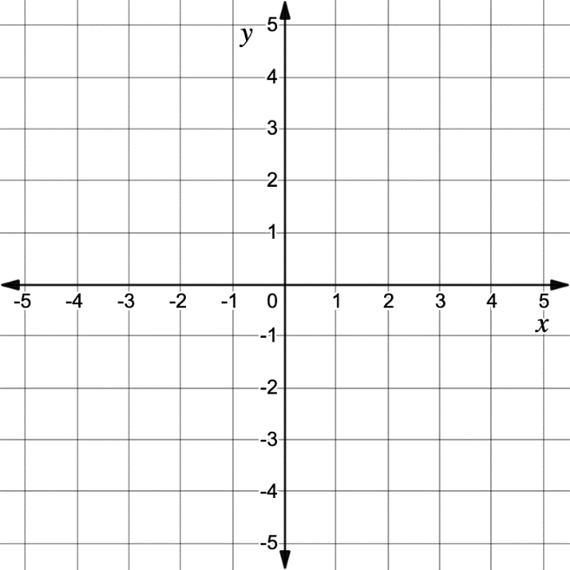
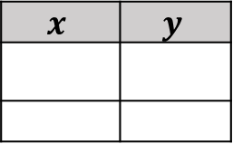
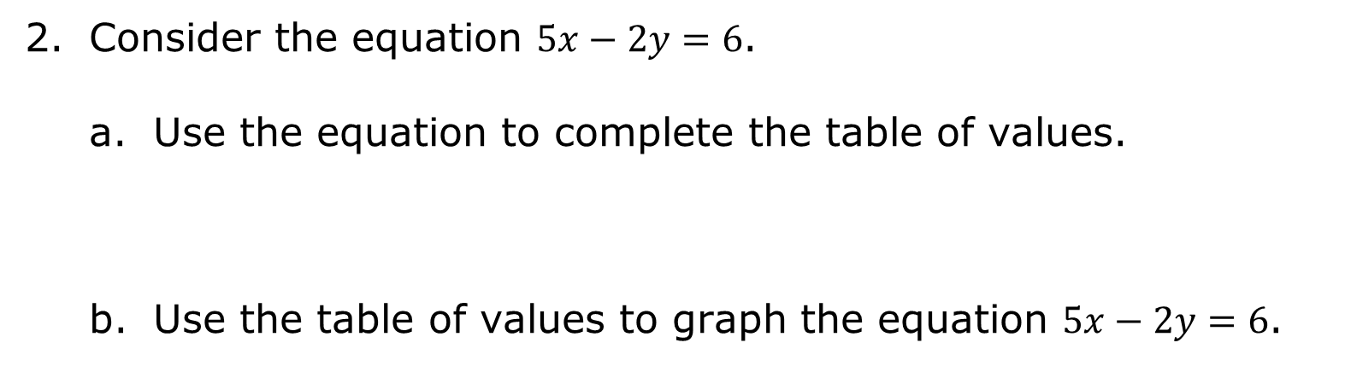
Consider the equation $5x−2y=6$.
Use the equation to complete the table of values.
Use the table of values to graph the equation $5x−2y=6$.
$$x$$ | $$y$$
volume 1, pg. 303

Slide 26
What is the slope of the line?
volume 1, pg. 303

Slide 27
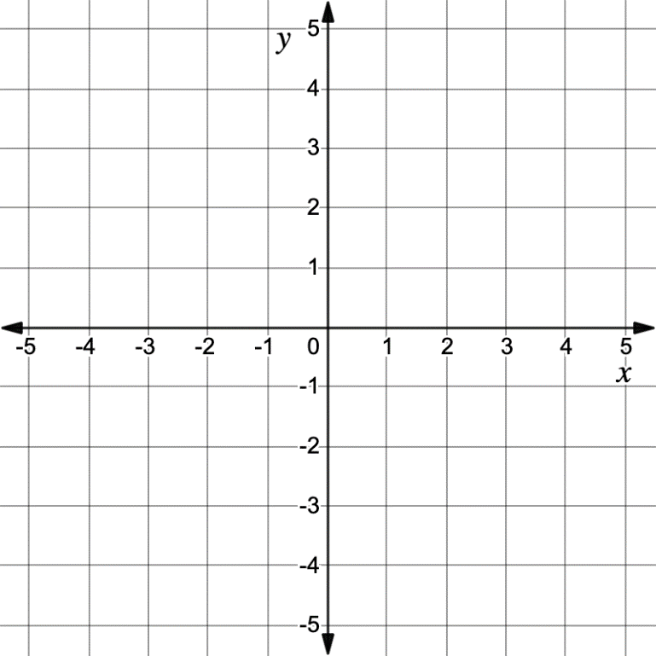
Graph the equation $y=−\frac{1}{5} x+1$.
volume 1, pg. 304

Slide 28

Wrap-Up
volume 1, pg. 304

Slide 29
7.4.6 Wrap-Up: Reflection
Complete the learning pyramid based on today’s lesson.
One question I would like to have answered …
One mistake I learned from today …
One thing I am not sure about … YET!
One thing I am confident I know is …
volume 1, pg. 304

